Slide 1
Picasso’s
A framing shop inventory tracking program created in partial fulfillment of CIS 545, Extensible Markup Language
Group Members:
Manfred Ayers
Letitia Murdoch
Mark Thompson
Fernando Zamora

Slide 2
Business Description
Small family-owned framing business
Provides custom framing needs for the Temple, Killeen and surrounding areas.
Picasso’s attempts to cut every mat, molding, and sheet of glass to the exact requirements the customer desires.
prepared to stock the most common supplies and custom ordered supplies

Slide 3
Business Description Continued
common turnaround span of five days from order to delivery
Special turnaround time can be as much as two weeks longer than normal
Picasso’s must take all costs incurred into account in order to price the items adequately
cost of these supply items is a significant consideration

Slide 4
Framing Equipment and Supplies
3 Mat Cutters - Fletcher
1 Molding Chopper
1 molding Miter Saw
1 Computerized Matt Cutting Machine – Wizard Model 8000
1 Oval Mat/Glass Cutter
1 Regular Glass Cutter
Dry Mount Press
2 Miter Vice
Other hand tools such as tape guns, multi-point drivers, wire cutters, screw drivers, utility knives, pencils, etc,

Slide 5
Framing Equipment and Supplies Continued
Mats varied by different colors and types
molding – This is the actual pieces used for the frame
Glass – There are several types and sizes
Foam Core Backing
Glue
Glass Cleaner
Hanging Wire and Screws
Pencils
Other miscellaneous items

Slide 6
The Inventory System
The artifacts within the system are:
the picassosinventory.xsd
XML data
picassoinventory.xsl stylesheet to enable viewing of the system through a browser
Picasso Inventory System which enables the CRUD (Create, Update, Read, Delete)

Slide 7
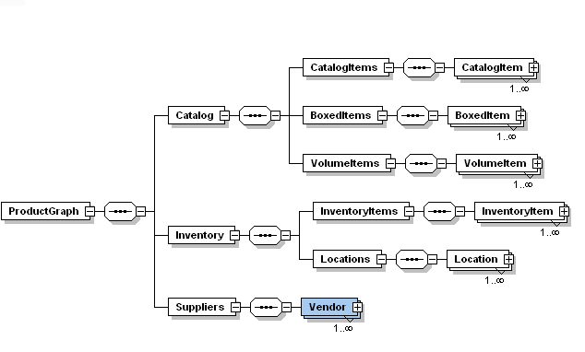
Inventory Schema

Slide 8
Element with Attributes
Vendors
Id
Name
Contact Person
Phone Number
Comments
Address
Street
City
State
Zip

Slide 9
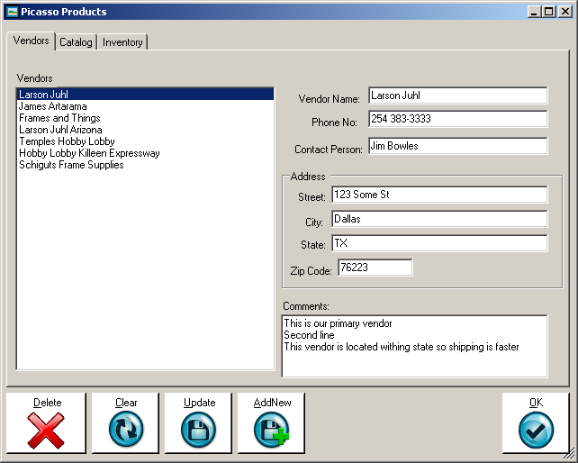
Vendor Screen

Slide 10
Elements with Attributes Continued
Catalog Item
Id
Vendor Id
Unit Cost
Category
Single Item
Boxed Item
Quantity in Box
Box Cost
Volume Item
Unit of Measure
Minimum Quantity

Slide 11
Catalog Item ID
Catalog Item Id
Comments
Inventory Location
Name
Description
XSD Schema explained

Slide 12
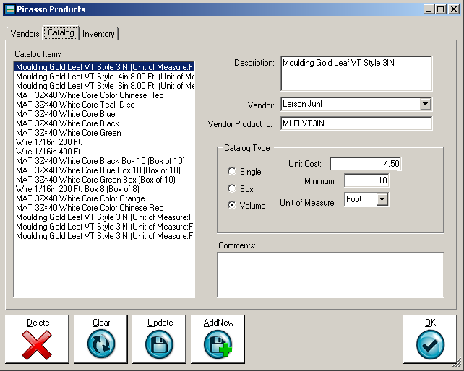
Catalog screen

Slide 13
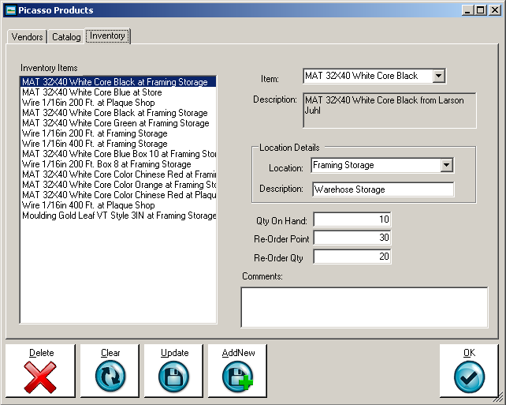
Inventory System

Slide 14
Database Entry
fully supports the data validation required by the products.xsd schema
written in C# using the 3.5 .Net framework
includes the following tiers:
Database – In the form of an XML data file
Data Access Layer – The mechanism to read the file was file IO
The Model was in the form of Plain Old C-Sharp Objects (POCOs)
The UI Layer was in the form of a windows form with three tabs

Slide 15
Database Entry Continued
allows the creation of a new inventory database.
allows all basic Create, Read, Update and Delete (CRUD) operation
Sample Output

Slide 16
Inventory XML Transformation
Challenges:
Ability to Display the vendor, unit price, and description
Alternating colors for rows
the catalog items are dispersed across three different paths of the XML tree:
ProductGraph/Catalog/CatalogItems/CatalogItem
ProductGraph/Catalog/BoxedItems/BoxedItem
ProductGraph/Catalog/VolumeItems/VolumeItem

Slide 17
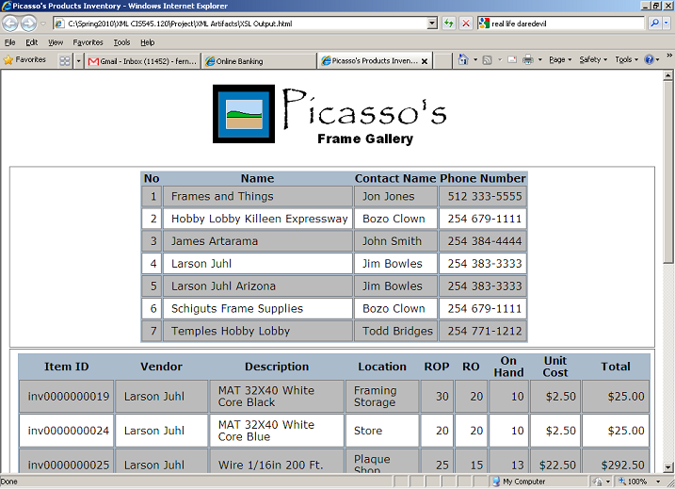
Sample HTML Report after transformation

Slide 18
Paper Transformation
XLS necessary to transform the XML,
Cascading Style Sheet configuration to properly format the HTML content.
CSS code enabled us to perform the following feats.
Format the Title Appropriately in upper case
Format all Level 1 Headers
Format all Level 2 Headers
Format our figures to a uniform size
Provide the proper spacing between sections
Properly size the paragraphs
Properly indent the bulleted lists base on level
Properly format the bibliography

Slide 19
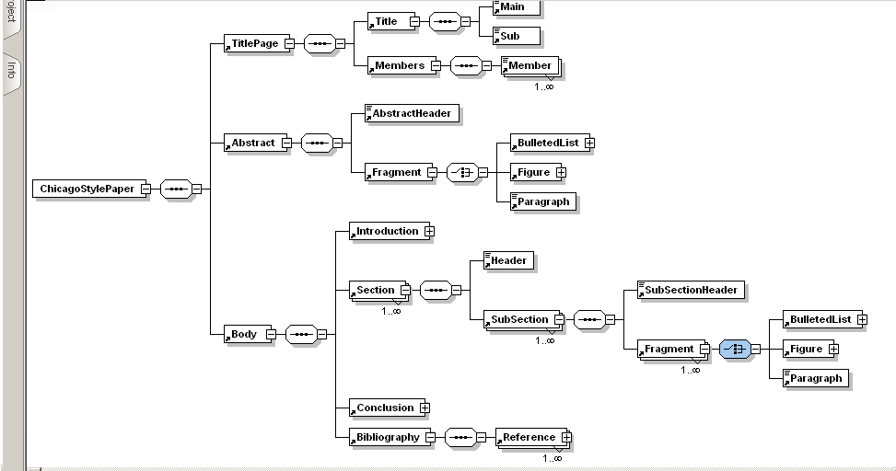
Chicago Manual of Style Paper Schema

Slide 20
Questions?
Thanks for your attention!

